Slide 1
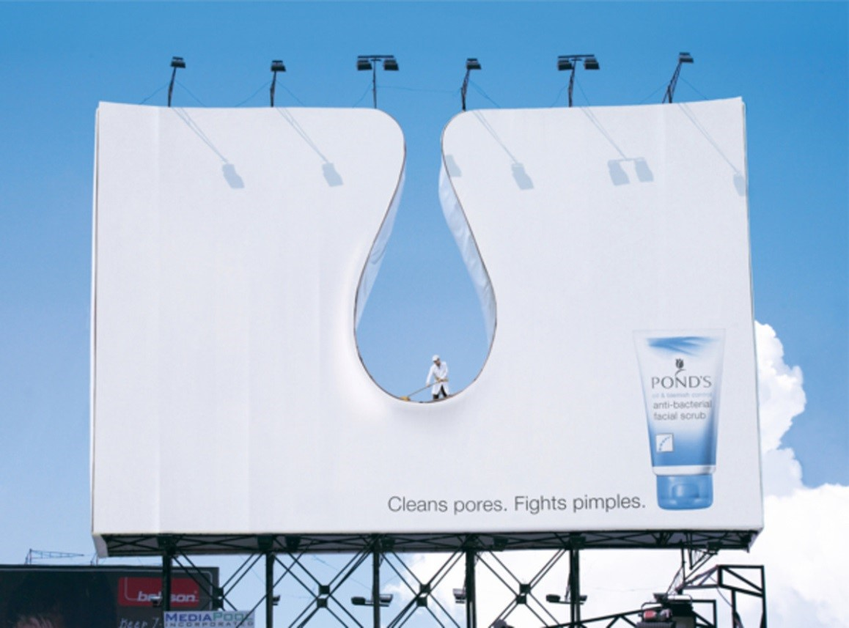
higher Design & Manufacture
Market

Slide 2


Learning intentions & success criteria
Learning Intentions
Introduction to the design factor, market.
Success Criteria
Explain what is meant by the market.
Describe and explain the different aspects of product promotion, market research, target market etc.

Slide 3

What is market?
The opportunity for new products arises from development in technology or customer need.
The effective design of these products does not just consider how they work. It also has to take into account a broad range of issues and factors including:
  Social
  Cultural
  Market
  Environmental

Slide 4
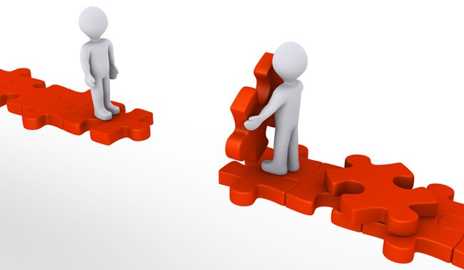
market
Commercial products are designed and made to be sold.
The market (potential buyers) at which the product is aimed will influence its development and how it is promoted.
Successful products meet consumer needs and often fill a gap in the market.
To understand the consumer’s needs and wants, market research should be carried out.

Slide 5

Market research
This involves gathering data about potential buyers, competitors and market trends
Accurate market research reduces the risk associated with launching new or improved products
Research may be carried out using a range of techniques e.g. surveys, questionnaires, user trials etc.
To generate useful information the market research must be aimed at the correct market, known as the target market.

Slide 6

Target market
Market is everything to do with who will buy the product, where/when it will be sold, how much it will cost etc.
Target Market is the group of people who the product will be aimed at. The target Market is influenced by:
  Geographic: region, size of population, climate etc.
  Demographic: age, gender, income, education, occupation, household size
  Psychographic: attitudes, values, opinions, lifestyles
  Behavioural: (relationship to a product): brand loyalty, first time buyer, regular buyer, occasions that stimulate purchases

Slide 7
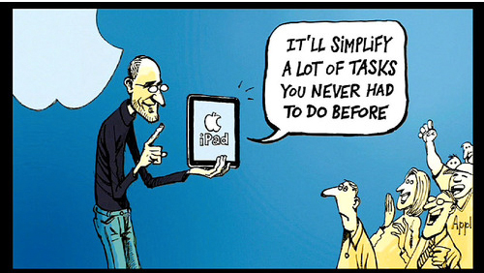
Pull and push
Market Pull, Technology Push:
Designers identify the opportunity to develop new products based on technology push or market pull.

Slide 8

Technology push
Technology push is when products are re-designed because of changes in materials or manufacturing methods.
This might mean that:
  New materials have become available
  Improved properties
  Improvements in manufacturing processes mean a manufacturer can make the product cheaper or more efficiently
  Reduces manufacturing costs.

Slide 9

Market pull
Market pull is when product ideas are produced in response to market forces.
Examples of market influences include:
  A demand from consumers for new or improved products.
  A competing product is launched by another manufacturer.
  A manufacturer wants to increase their share of the market.

Slide 10
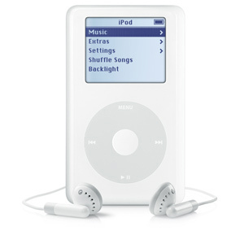
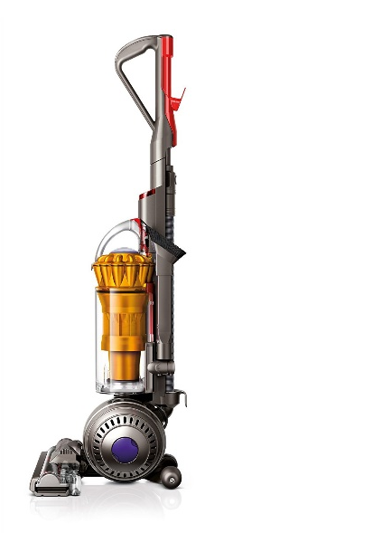
Other reasons
Sometimes a designer will design a new or improved product simply because they believe that the very existence of the product will create market pull.
Designs like this may succeed or fail, depending on consumer demand, how innovative the product is, and the state of the market.

Slide 11
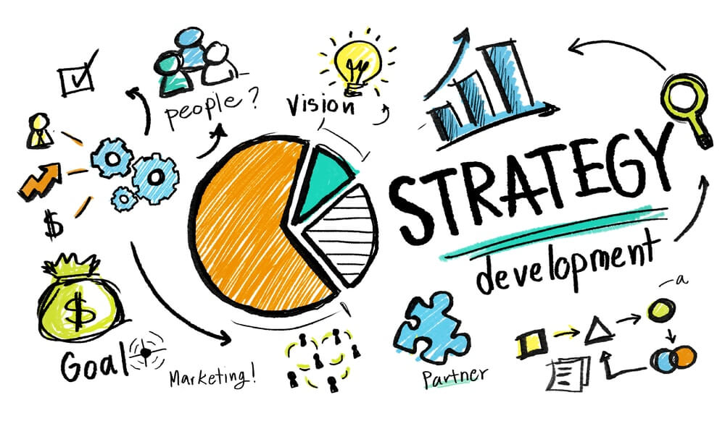
Marketing strategy
Marketing strategy is to match products with the people who want or need them
When marketing products, companies need to create a successful marketing mix, known as the four Ps:
  The right PRODUCT: it must have the right features to appeal to the target market
  Sold at the right PRICE: it must be able to compete in the market and make a profit
  In the right PLACE: right place, right time e.g. retail store, online or special events
  Using a suitable PROMOTION: target group need to be made aware of the product.

Slide 12

Beyond advertising
Marketing is more than just advertising and sales…
…it is everything a company does to get customers and keep them.
It is also about aftersales activity, such as providing support and dealing with complaints

Slide 13

Niche marketing
Niche marketing concentrates all marketing efforts on a small and well-defined segment of the population.
Companies that concentrate on niche segments aim to be successful by being a ‘big fish in a small pond.’
This has several advantages and disadvantages.

Slide 14

Niche marketing
Advantages:
  Less competition of production
  Clear focus: easier to target customers
  Builds up market expertise
  Customers may pay higher prices and be more loyal
Disadvantages:
  Can be expensive due to low volumes
  Over-dependence on a single product
  Success will attract competition
  Very vulnerable to market changes

Slide 15

brands
A brand is much more than simply a name or a logo
A brand consists of all the impressions and experiences associated with a company or product.

Slide 16
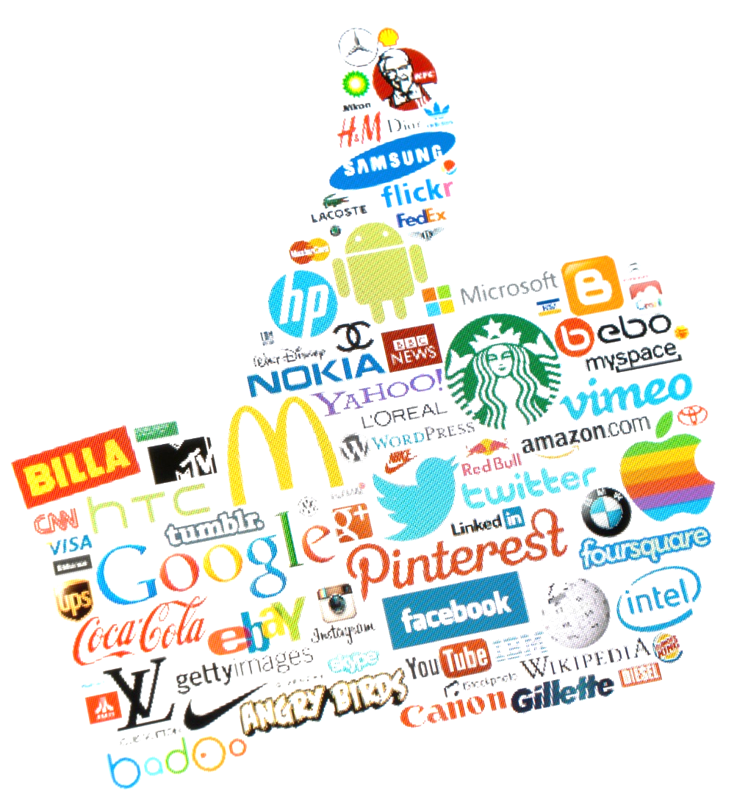
brands
Branding is the sum of things such as:
  Reputation
  Attitude
  A promise
  Logo
  Products
  Feeling
  Customer service

Slide 17
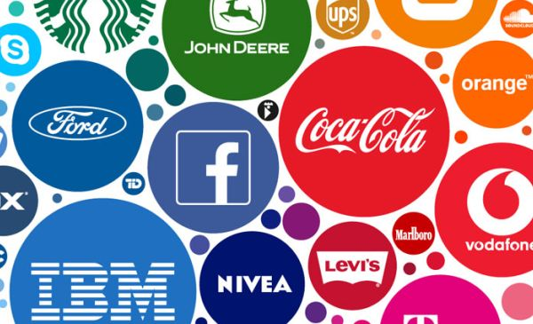
brands
Customers can relate to a brand on a rational and on an emotional level can develop brand loyalty.
There are different levels of brand loyalty:
  Brand recognition: the consumer knows something about the brand
  Brand preference: the consumer prefers the brand but will buy another if it is not available
  Brand insistence: the consumer will only buy the brand.

Slide 18
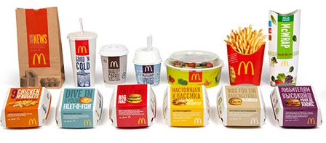
Brand identity
Companies try to create a consistent and recognisable image, known as a brand identity.
This includes:
  Brand name
  Logos
  Tagline
  Personalised symbols or characters.
These elements used should be used to reinforce brand values every time there is contact (a touch point) with the consumer e.g.
  Person-to-person, online, an app, any form of communication

Slide 19
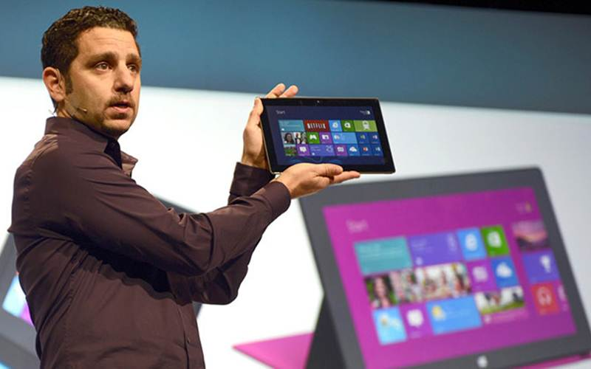
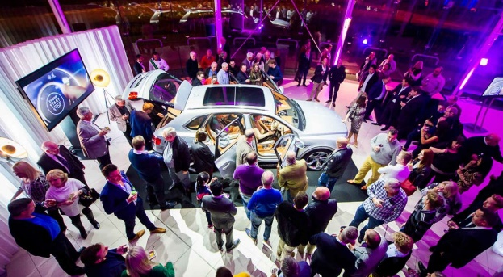
Product launch
It is difficult to launch a new product onto the market
Most launches actually fail!
Reasons for failure:
  Market research
    Little or no research, might be interesting but lacks precise target
  Finance and distribution
    Most of the budget spent on developing the product, slow distribution than expected, supplies insufficient to demand
  Differences in an updated product
    Sales, retailers and target market may not have been educated about the changes to the new product
  Problems with the product
    Issues with quality, function, safety. Price may be too high

Slide 20
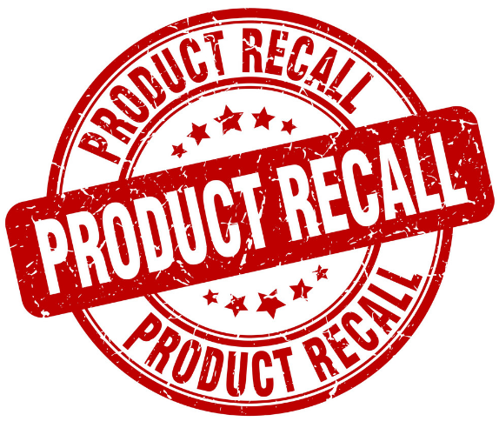
Product recall
The impact of a product recall can be minimised if a company handles it well
If it is, it can actually enhance a company’s reputation
It typically involves the following:
  Everyone involved with manufacture and sale is informed
  All customers should be informed of defects and procedures to rectify the problem
  A recall management team should be set up
  Production should be suspended if required
  Quality assurance processes should be updated

Slide 21

patents
Designers and Manufacturers often patent their designs, meaning:
  Legal protection for their ideas
  No one can profit from your ideas without permission
  Competitive edge on other manufacturers
  Can be licenced or sold
  Seen as a market leader
  Perceived as innovative

Slide 22
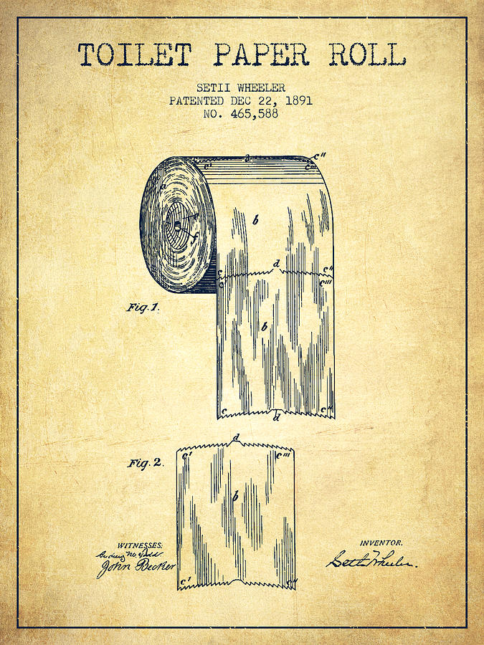
patents
Some examples of patents include:
  Flaked cereal by Harvey Kellogg
  Corrugated glass bottle tops
  Toilet roll
  Post-it notes

Slide 23
Question
The opportunity for new or improved products can arise from technology push or market pull.
(a) Describe technology push and market pull and give an example of how each has influenced the design of products (4 marks).
Market research plays an important part in the development of every new product.
(b) Describe the information that could be gained through the use of market research (2 marks).

Slide 24
